Slide 1
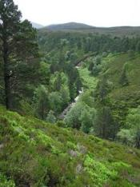
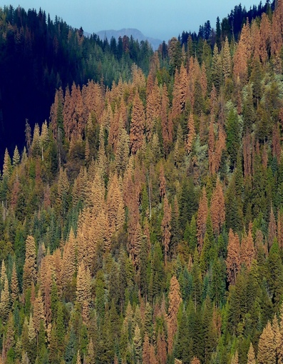

Probabilistic Risk Analysis (PRA) and Bayesian Decision Theory (BDT)
Marcel van Oijen
(Independent scientist,
Edinburgh, U.K.)
Mark Brewer
(Biomathematics and
Statistics Scotland)
USGS CC PDM 1.0
Workshop IBS-Germany & DVFFA, Lübeck, 2025-09-24-26

Slide 2
Contents
Introduction to PRA: Basic ideas & equations
Model-based PRA
Beyond the basic theory
Introduction to BDT
Links between PRA and BDT
General discussion
Contents based on Van Oijen & Brewer (2022), with extensions and some corrections
Exercises - simple calculation or R-programming - to initiate discussion
Main questions to all:
What is missing from these lectures and/or VO & B (2022)?
Which of the methods could you use in your own work?

Slide 3
1. Introduction to PRA: Basic ideas & equations
USGS CC PDM 1.0
Workshop IBS-Germany & DVFFA, Lübeck, 2025-09-24-26

Slide 4
Terminological confusion
HAZARD | PROBABILITY OF HAZARD | VULNERABILITY
Initiating event | Probability of undesirable consequences | (Severity of) consequences
Threatening event | Exposure | (Degree of) loss
Potentially damaging agent |  | Biophysical v., Socio-economic v.
Natural disaster |  | Contextual v., Outcome v.
Natural hazards |  | Susceptibility (to damage)
 |  | Sensitivity
 |  | Fragility
 |  | Impact
 |  | Damageability

Slide 5
Terminological confusion
Lecina-Diaz et al. (2020):
“where E are the exposed values (here represented by the ES
provided by a forest), HM is the hazard magnitude (weighted
by its probability distribution), S is susceptibility, and LAC is
the lack of adaptive capacity within a given time frame”
IPCC (2014):
“Risk is often represented as probability of occurrence of hazardous events or trends multiplied by the impacts if these events or trends occur. Risk results from the interaction of vulnerability, exposure, and hazard.”
“Vulnerability: The propensity or predisposition to be adversely affected. Vulnerability encompasses a variety of concepts and elements including sensitivity or susceptibility to harm and lack of capacity to cope and adapt.”

Slide 6
Risk matrices
National Risk Register (2017)
CAA (2014)

Slide 7
Risk matrices
p[H] × V = 3 × 4
p[H] × V = 4 × 3
p[H] × V = 5 × 2
What is the highest risk??
V
p[H]

Slide 8
Risk matrices
Can we define V and p[H] such that Risk = V * p[H] is well-defined ?
V
p[H]

Slide 9
Toward formal theory for PRA: Notation
Environment
x
System
z
H = Hazardous conditions
p[ x ∈ H ] = p[H] = Probability of hazardous conditions
E[ z ] = Expectation for system performance
E[ z | H ] = Expectation for system performance
under hazardous (”bad”) conditions
E[ z | ¬H ] = Expectation for system performance
under non-hazardous (“good”) conditions

Slide 10
PRA: basic equations
Standard definition of risk
Standard definition of hazard probability
Logical definition of vulnerability
Vulnerability (V) is the difference in expected system performance (E[z|.]) between non-hazardous (¬H) and hazardous conditions (H).

Slide 11
Data needs are minimal for basic PRA
Cause
Effect
“Hazardous conditions” = “rainfall <= 2 mm d⁻¹”
A:
B:
C:
D:
E:
E(sys|env non-hazardous) = 9 g m⁻² d⁻¹
E(sys|env hazardous) = 3 g m⁻² d⁻¹
Vulnerability = A-B = 6 g m⁻² d⁻¹
p[env hazardous] = 0.3
Risk = C*D = 1.8 g m⁻² d⁻¹
Note that Risk can also be calculated in the standard way as E[sys|env non-hazardous] – E[sys] = 9 - 7.2 = 1.8

Slide 12
A simple method for risk decomposition
E[sys]
RISK = Average loss
VULNERABILITY
thr
p[Hazardous] =
frequency env < thr =
n_{H} / n
RISK =
VULNERABILITY * p[Hazardous]

Slide 13
Example: Risk analysis for NPP
NPP in good years
VULNERABILITY
(= Difference NPP good-bad)
RISK
(= Prob.*VULNERABILITY)
NPP in bad years
Probability of bad years

Slide 14
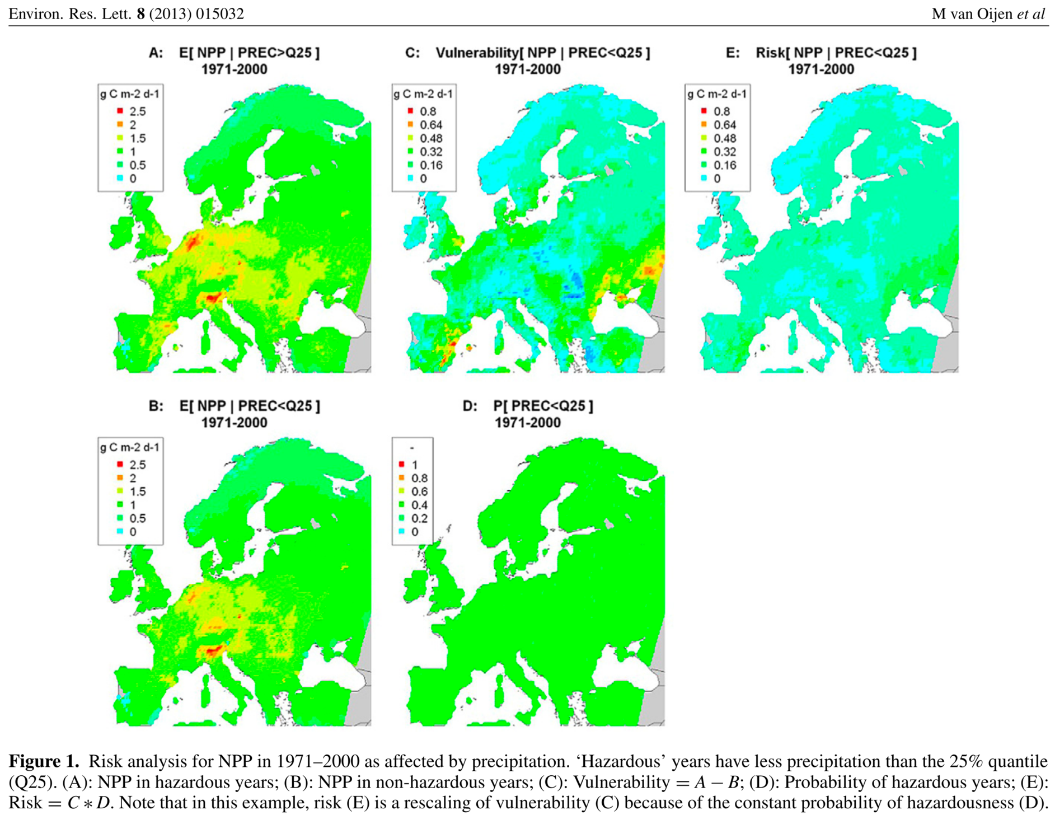
PRA coniferous forests (WATCH, EMEP, BASFOR)

Slide 15
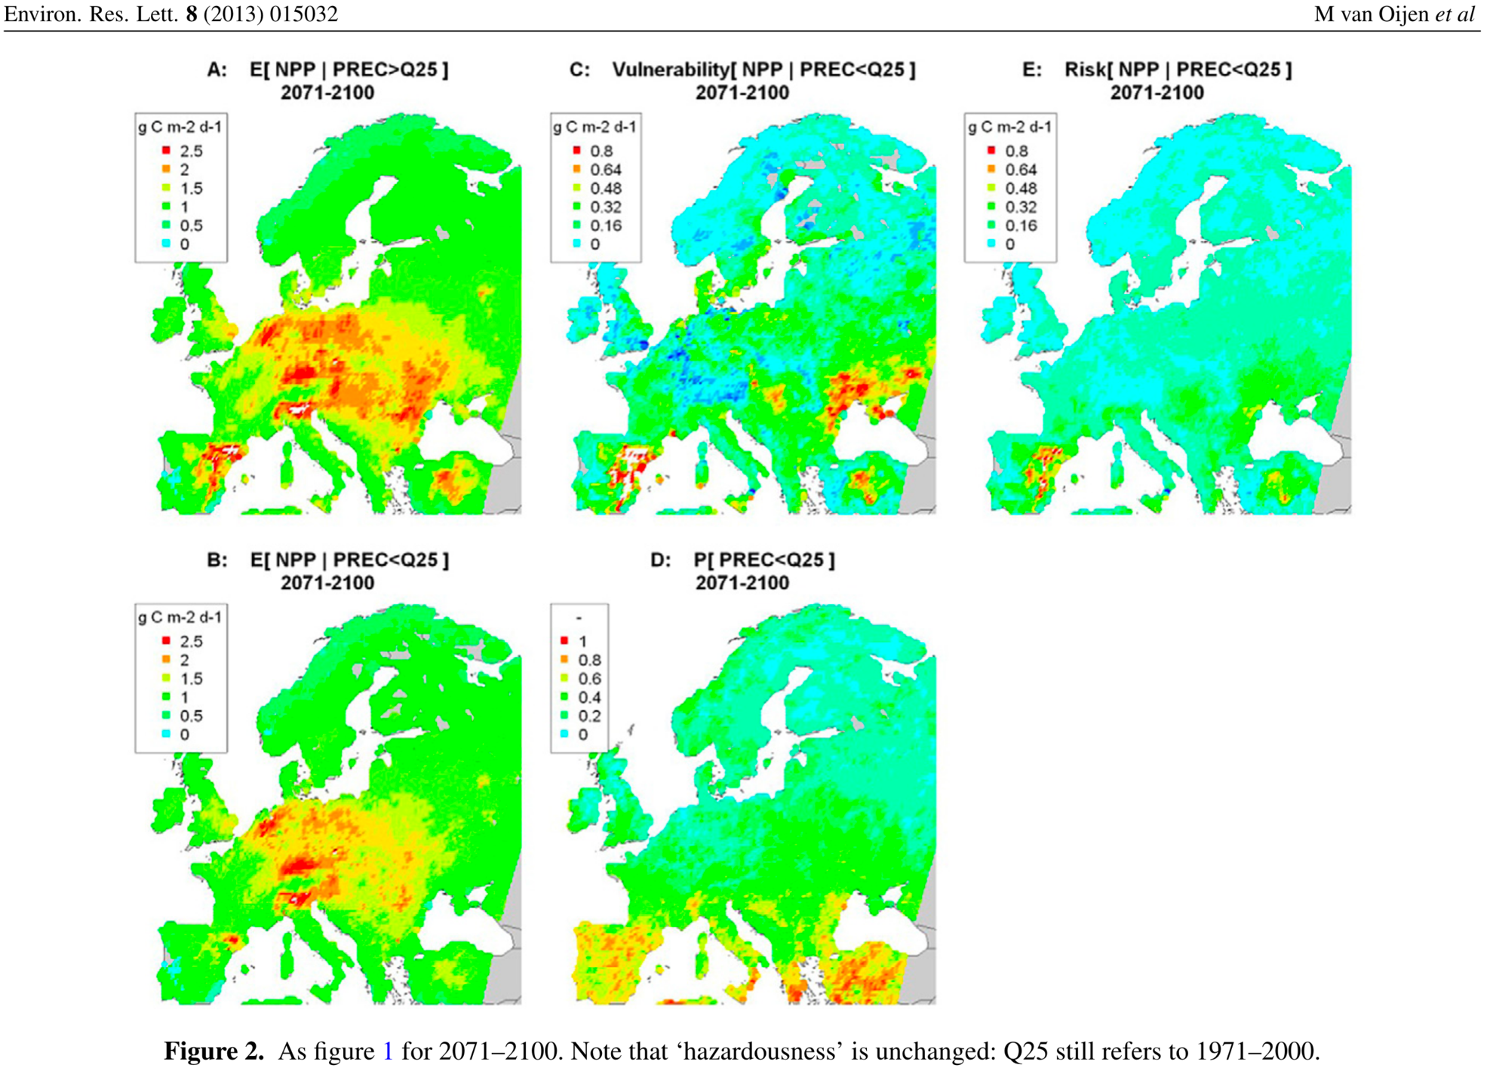
PRA coniferous forests (MPI-Remo, EMEP, BASFOR)

Slide 16
6 models: average NPP in 1971-2000
Van Oijen et al. (2014)
Biogeosciences

Slide 17
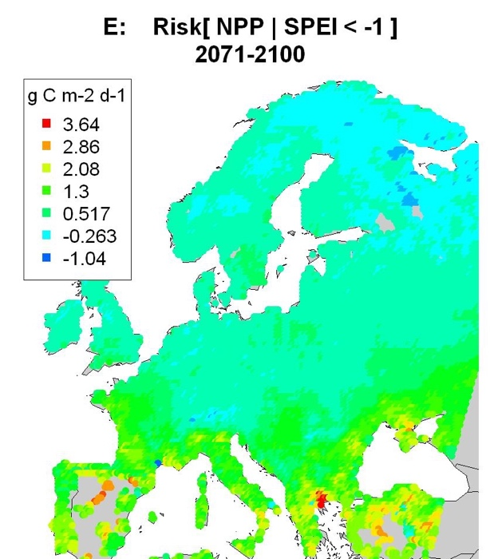
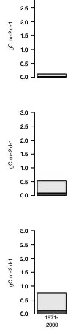
Risk analysis NPP (model LPJ) per latitudinal band
latitude > 55 °N
VULNERABILITY (high-latitude)
RISK (high-latitude)
45 < lat. < 55 °N
latitude < 45 °N
VULNERABILITY (mid-latitude)
RISK (mid-latitude)
VULNERABILITY (low-latitude)
RISK (low-latitude)

Slide 18
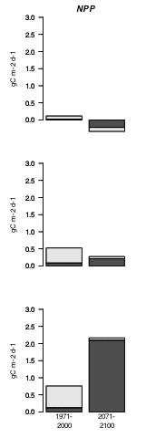
Risk analysis NPP (model LPJ) per latitudinal band
Left: 1971-2000, Right: 2071-2100

Slide 19
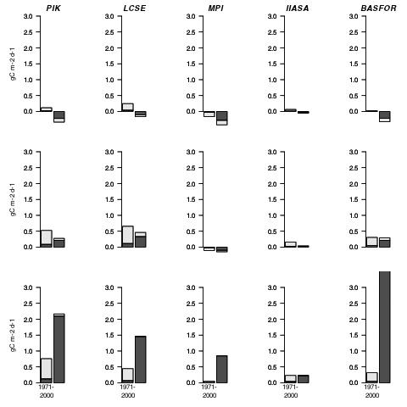
Risk analysis NPP: 5 models
LPJ
(generic)
ORCHIDEE
(generic)
JSBACH
(generic)
EPIC
(wheat)
BASFOR
(pine)

Slide 20
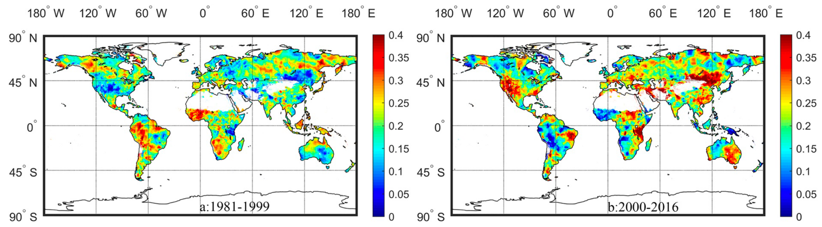
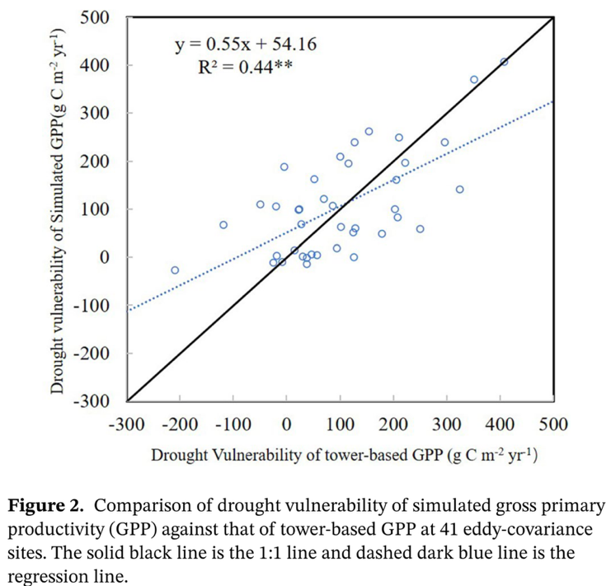
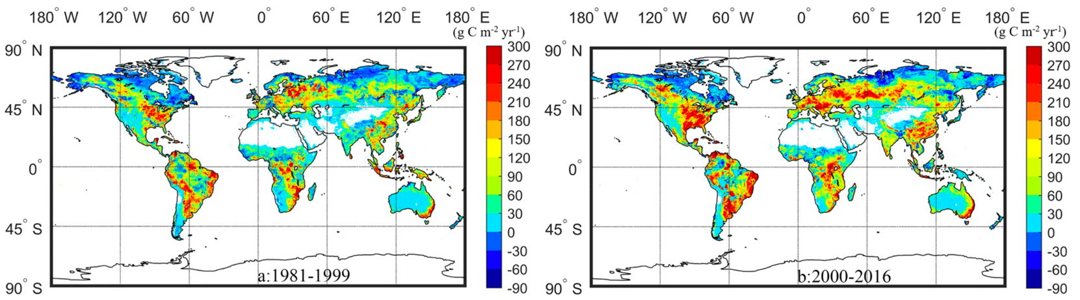
He et al. (2021). Drought Risk of Global Terrestrial Gross Primary Productivity Over the Last 40 YearsDetected by a Remote Sensing-Driven Process Model
1981-1999
2000-2016
p[H]
V

Slide 21
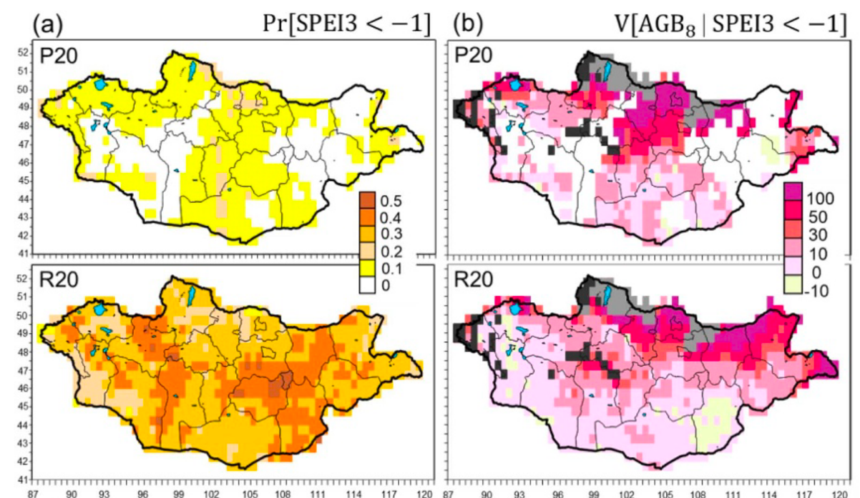
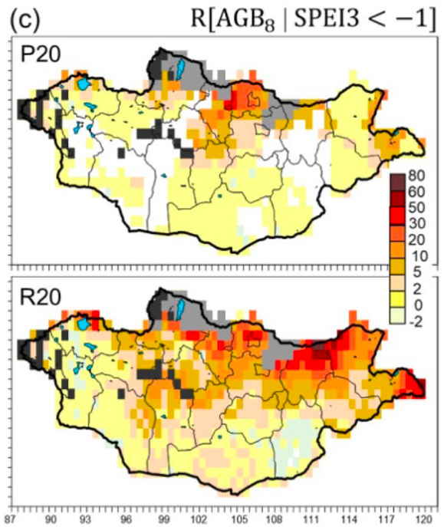
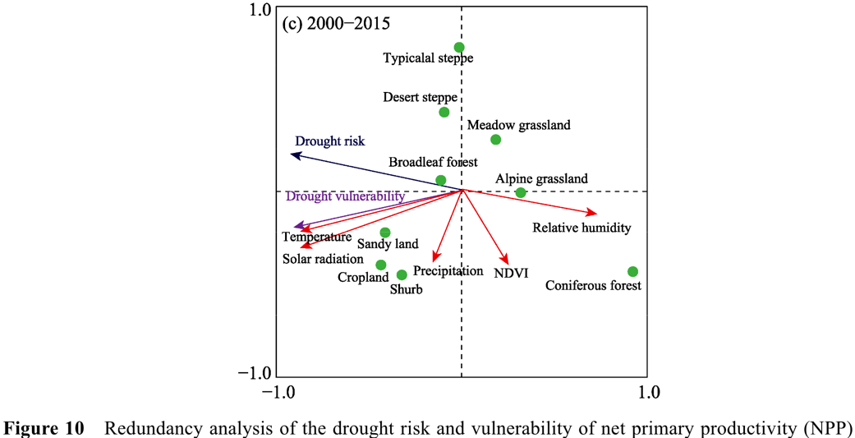
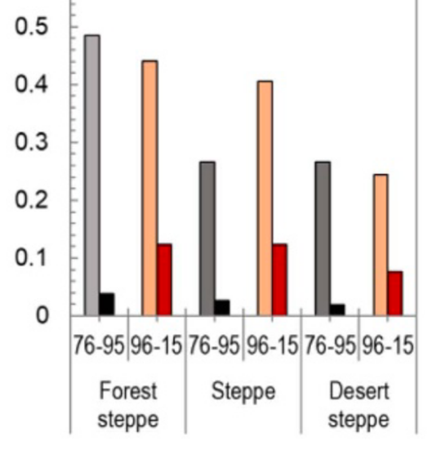
Nandintseg et al. (2021). Risk and vulnerability of Mongolian grasslands under climate change
p[H]
V
R
1976-1995
1996-2015
V
R
Ren et al. (2023)

Slide 22
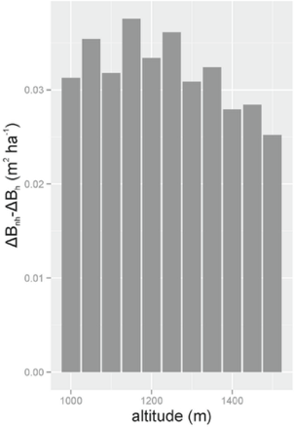
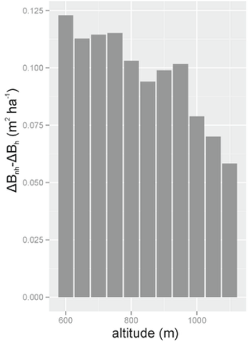
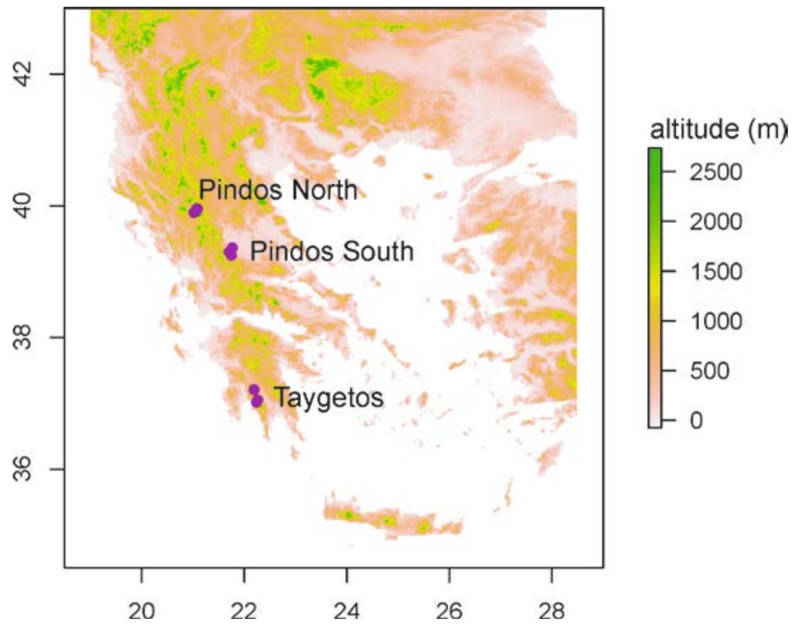
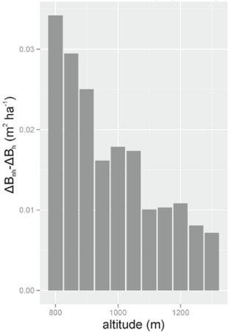
Fyllas et al. (2015). Mediterranean Forests in Transition (MEDIT): Deliverable No9
Vulnerability of tree growth to climate change as f(altitude)
V
V
V

Slide 23
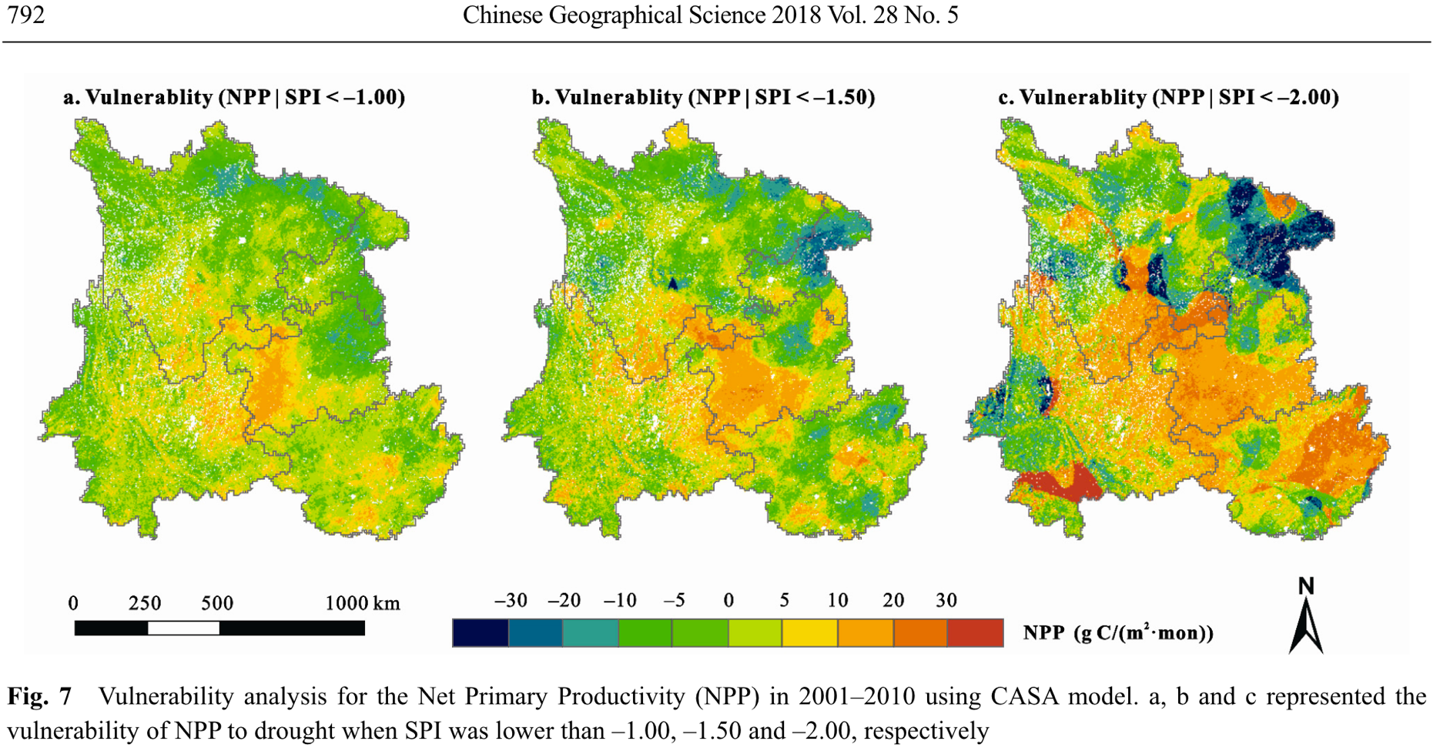
Zhou et al. (2018). Drought Impacts on Vegetation Indices and Productivity of Terrestrial Ecosystems in Southwestern China During 2001–2012

Slide 24
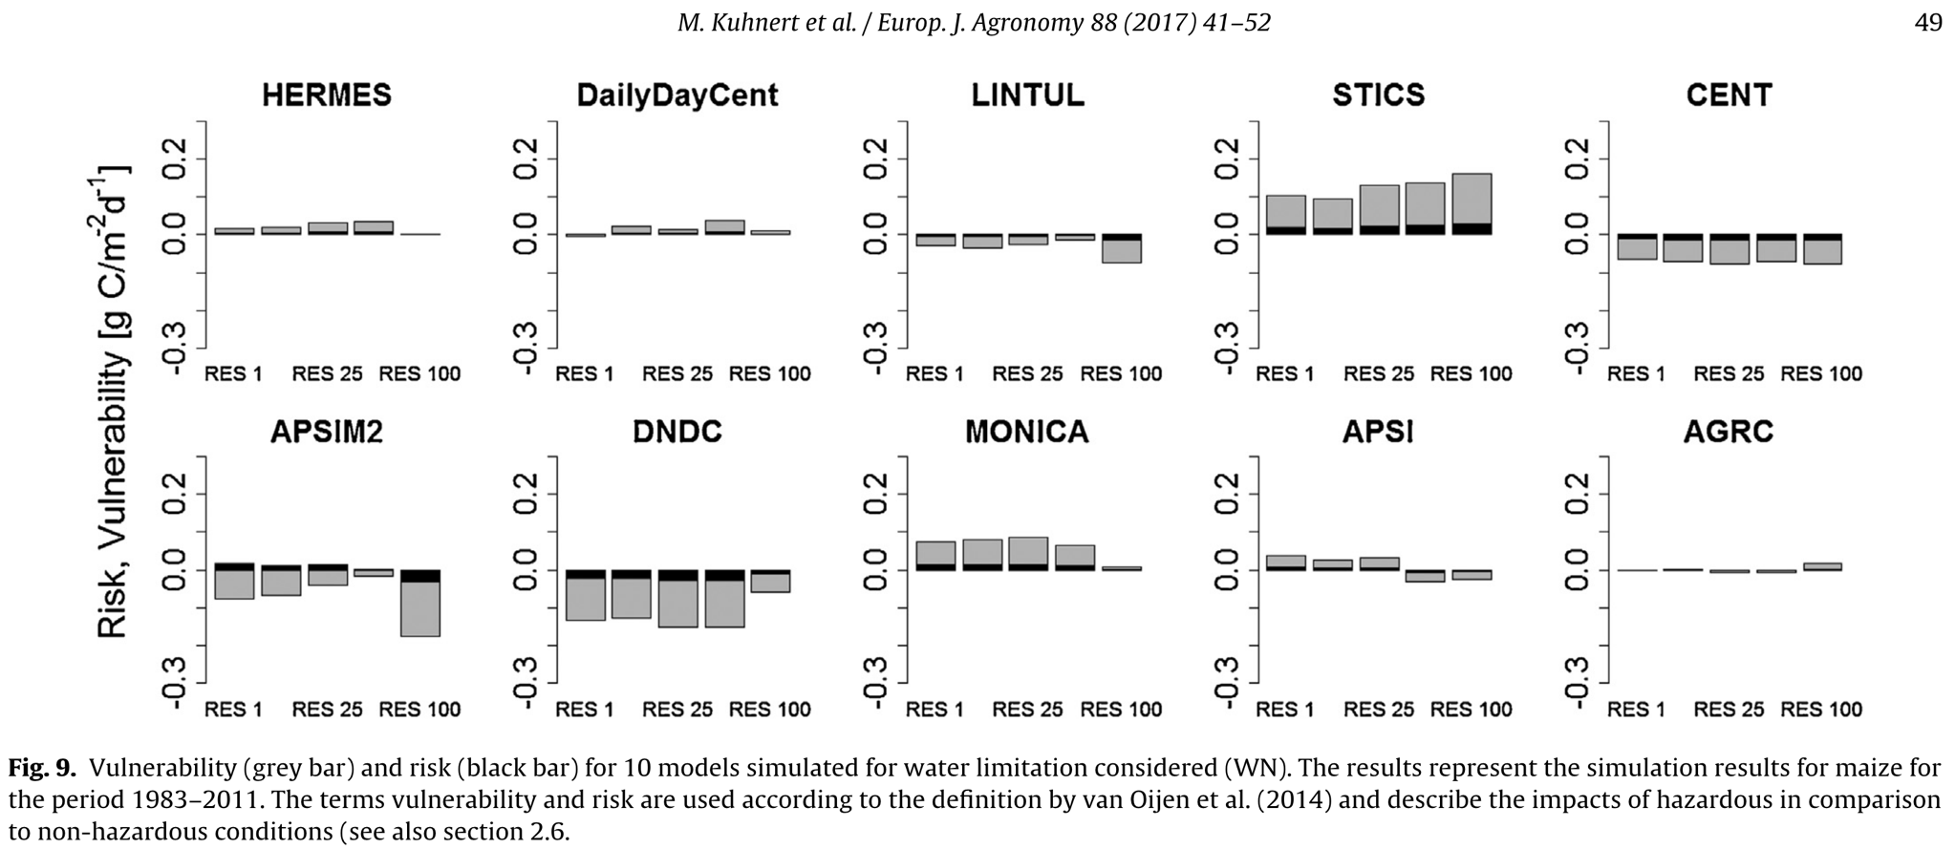
Kuhnert et al. (2017). Impact analysis of climate data aggregation at different spatial scales on simulated net primary productivity for croplands
Drought risk to NPP of maize in North Rhine-Westphalia
V,
R

Slide 25
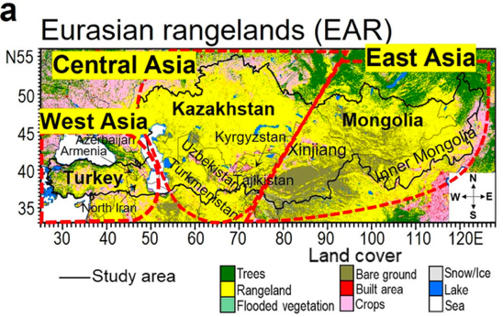
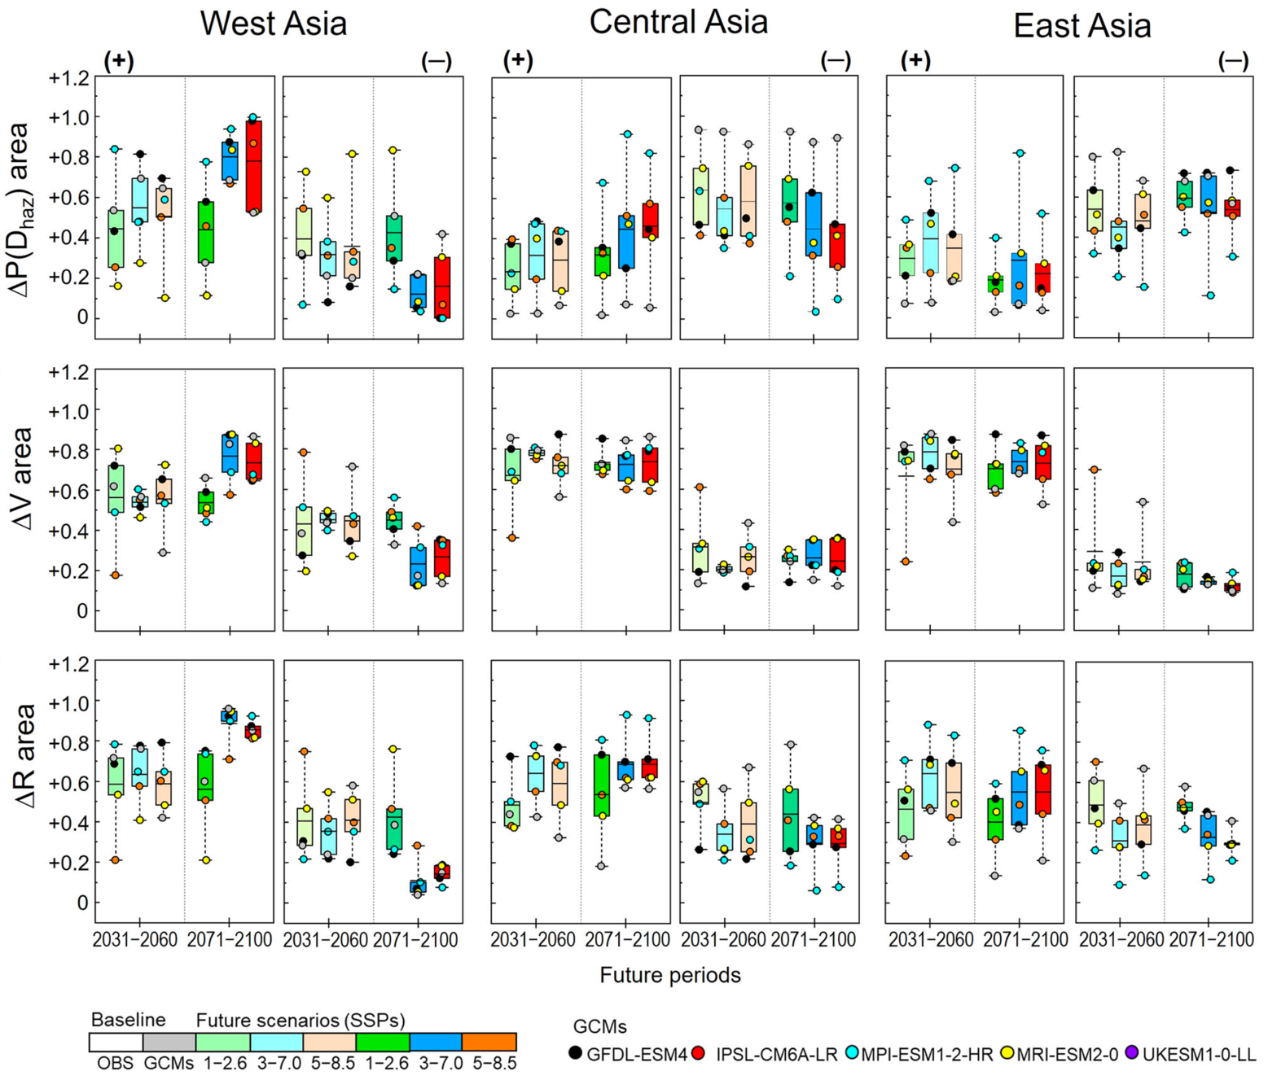
Nandintseg et al. (2024). Future drought risk and adaptation of pastoralism in Eurasian rangelands
Uncertainty p[H]
Uncertainty p[H]

Slide 26
Toward UQ (Uncertainty Quantification)
thr
n_{H} observations below threshold
n-n_{H}
observations above threshold

Slide 27
Toward UQ (Uncertainty Quantification)
E[sys]
R
V
thr
p[H] = n_{H} / n

Slide 28
Uncertainty Quantification (UQ)
E[sys]
R
V
thr
p[H] = n_{H} / n

Slide 29
R-function for single-threshold sampling-based PRA
PRA <- function( x, z, thr=0 ) {
n <- length(x)
H <- which(x < thr) ; n_H <- length(H)
Ez_H <- mean( z[ H] )
Ez_NotH <- mean( z[-H] )
s_Ez_H <- sqrt( var(z[ H]) / n_H )
s_Ez_NotH <- sqrt( var(z[-H]) / (n-n_H) )
pH <- n_H / n
V <- Ez_NotH - Ez_H
R <- pH * V
s_pH <- sqrt( pH*(1-pH) / n )
s_V <- sqrt( s_Ez_H^2 + s_Ez_NotH^2 )
s_R <- sqrt( s_pH^2*s_V^2 + s_pH^2*V^2 + pH^2*s_V^2 )
return( c(pH=pH, V=V, R=R, s_pH=s_pH, s_V=s_V, s_R=s_R) )
}

Slide 30
UQ: 1000 datasets from same distribution, thr=1
p[H] = 0.27, V = 0.464, R = 0.124
𝞂_{pH} = 0.04 , 𝞂_{V} = 0.040, 𝞂_{R} = 0.018
p[H] = 0.33, V = 0.410, R = 0.135
𝞂_{pH} = 0.05. , 𝞂_{V} = 0.035, 𝞂_{R} = 0.019
p[H] = 0.27, V = 0.464, R = 0.124
𝞂_{pH} = 0.04 , 𝞂_{V} = 0.039, 𝞂_{R} = 0.019

Slide 31
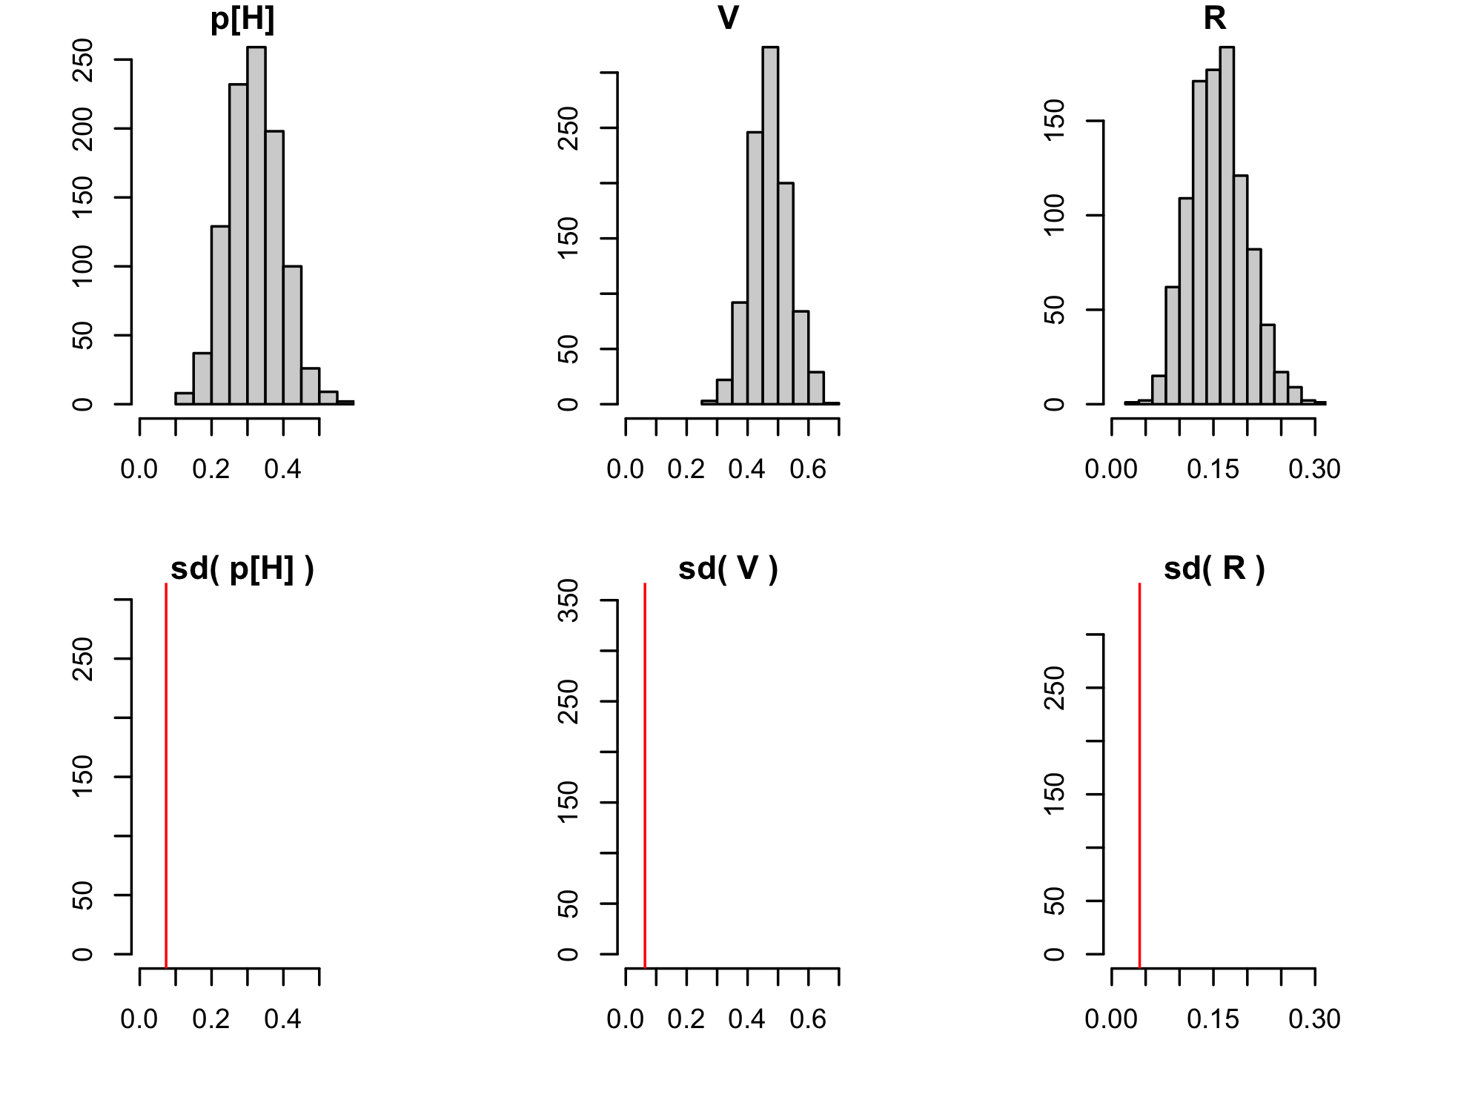
UQ: 1000 datasets from same distribution, thr=1

Slide 32
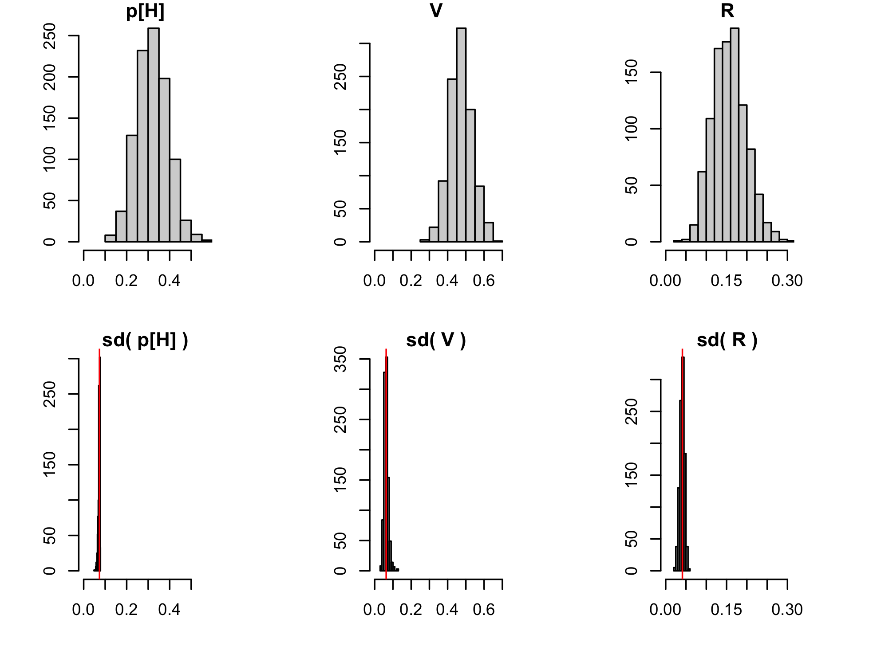
UQ: 1000 datasets from same distribution, thr=1

Slide 33
EXERCISE. Minimal data sets (sampling-based PRA)
x <- c( 200, 600 )
z <- c( 70, 90 )
PRA( x, z, 500 )
Will the uncertainty quantification work?
x <- c( 200, 400, 600, 800 )
z <- c( 70, 80, 90, 100 )
PRA( x, z, 500 )
Will the uncertainty quantification work?

Slide 34
EXERCISE. Minimal data sets (sampling-based PRA)
x <- c( 200, 600 )
z <- c( 70, 90 )
PRA( x, z, 500 )
pH V R s_pH s_V s_R
0.5 20.0 10.0 0.3535534 NA NA
x <- c( 200, 400, 600, 800 )
z <- c( 70, 80, 90, 100 )
PRA( x, z, 500 )
pH V R s_pH s_V s_R
0.5 20.0 10.0 0.25 7.0710678 6.373774

Slide 35
Forest data from Germany
https://www.umweltbundesamt.de/daten/klima/
2-bis-7_abb-tab_nsh_2024-04-08.xlsx
https://wo-apps.thuenen.de/apps/wze/
absterberate_EI_GFI_GKI_RBU_zeitreihe.csv
library( readxl )
d.data <- "data_Germany/"
file.data <- paste0( d.data, "2-bis-7_abb-tab_nsh_2024-04-08.xlsx" )
sheet.data <- "5_Daten” ; r.data <- "B120:C153"
y_r <- read_excel( file.data, sheet=sheet.data, range=r.data,
col_names=F )
y_r <- round( as.matrix(y_r) )
colnames(y_r) <- c( "year", "rain.mm" )
file.data <- paste0( d.data, "absterberate_EI_GFI_GKI_RBU_zeitreihe.csv" )
y_m <- read.csv2( file.data )
colnames(y_m) <- c( "year", "mort.%.Fs", "mort.%.Q_", "mort.%.Pa", "mort.%.Ps" )
y_r_m <- cbind( y_r, y_m[ , startsWith( colnames(y_m), "mort" ) ] )

Slide 36
Forest data from Germany
# Annual mortality vs. summer rain of last three years
meanlast <- function(v,k){as.vector(filter(v,f=rep(1/k,k),s=1))}
n <- dim(y_r_m)[1] ; k <- 3
r.3 <- meanlast(y_r_m[,"rain.mm"],k)[k:n]
z.Fs <- y_r_m[ k:n, "mort.%.Fs” ]
z.Q_ <- y_r_m[ k:n, "mort.%.Q_” ]
z.Pa <- y_r_m[ k:n, "mort.%.Pa” ]
z.Ps <- y_r_m[ k:n, "mort.%.Ps” ]
par ( mfrow=c(2,2) , mar=c(5,4,4,2) )
plot( r.3, z.Fs, main="Fs", xlab="" , ylab="mortality (%)" )
plot( r.3, z.Q_, main="Q_", xlab="" , ylab="" )
plot( r.3, z.Pa, main="Pa", xlab="rain (mm)", ylab="mortality (%)" )
plot( r.3, z.Ps, main="Ps", xlab="rain (mm)", ylab="" )

Slide 37
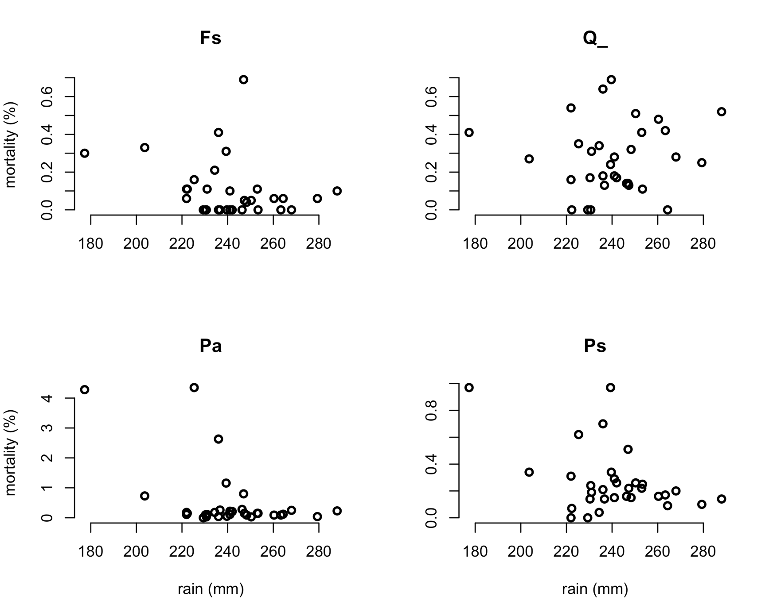
Forest data from Germany

Slide 38
Forest data from Germany: PRA
# PRA for survival (= 100 - mortality)
PRA_Ss.Fs <- PRA( x_r3, 100-z_Fs, thr=250 )
PRA_Ss.Q <- PRA( x_r3, 100-z_Q , thr=250 )
PRA_Ss.Pa <- PRA( x_r3, 100-z_Pa, thr=250 )
PRA_Ss.Ps <- PRA( x_r3, 100-z_Ps, thr=250 )
PRA._ <- as.matrix( cbind(PRA_Ss.Fs, PRA _Ss.Q_, PRA _Ss.Pa, PRA _Ss.Ps) )
colnames(PRA._) <- c( "Fs", "Q_", "Pa", "Ps" )
means <- PRA._[1:3,] ; s <- PRA._[4:6,]
par(mfrow=c(1,1))
col <- c( "red", "cyan", "yellow" )
bp <- barplot( means, beside=T, ylim=c(-0.2,1), col=col,
legend.text=row.names(means),
args.legend=list(x="top",hor=T) )
segments( bp, means - s, bp, means + s )
ew <- (bp[2,1]-bp[1,1])/4
segments( bp - ew, means - s, bp + ew, means - s )
segments( bp - ew, means + s, bp + ew, means + s )

Slide 39
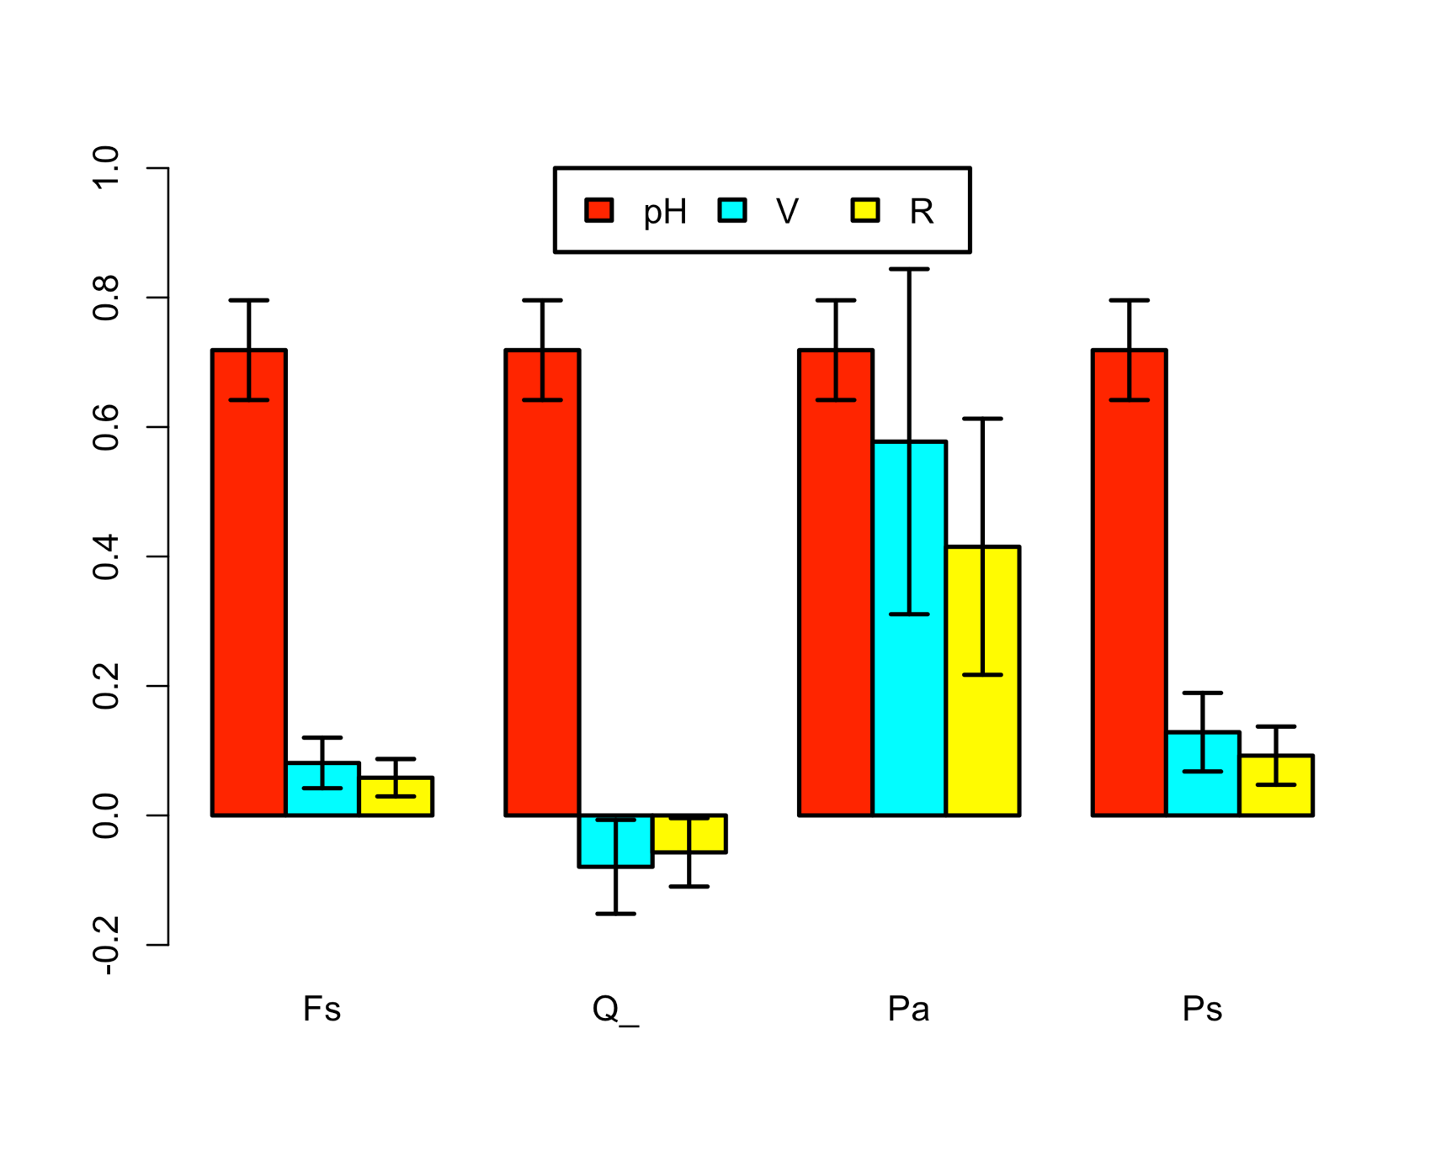
Forest data from Germany: PRA

Slide 40
Forest data from Germany: EXERCISE 1
Change the R-code: try other choices for the threshold. How does that affect the results?
Discuss limitations of the PRA.

Slide 41
Forest data from Germany: EXERCISE 1
Change the R-code: try other choices for the threshold. How does that affect the results?
Discuss limitations of the PRA. Possible answers:
Low n, large uncertainties.
Germany-average weather and mortality even though the tree species grow in different areas. p[H] the same for all species.
Arbitrary definition of hazard (average of last three summer-rain totals is less than thr = 250 mm).
Just one single hazard threshold.
No mechanistic understanding of causal factors, no gradual build-up of stress (increase of V) over years, no interactions with other hazard variables such as pests and diseases, …
No local definition of drought threshold (e.g. SPEI).
No normalised definitions of V and R.
…
Sometimes better! When?

Slide 42
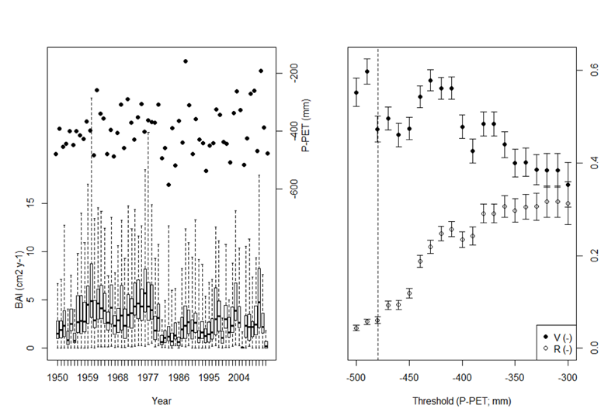
Van Oijen & Zavala (2019): P. sylvestris (El Carrascal, Spain)

Slide 43
Deriving p[H], V and R from data (3 methods)

Slide 44
Deriving p[H], V and R from data (3 methods)
Fit a distribution p[x,z] to the data (*)
Integrate conditional expectations E[z|x]
Derive p[H], V and R
(*) Copulas can map any p[x] and p[z] to p[x,z]
So we have freedom to choose appropriate probability distributions for environment x and system z

Slide 45
Deriving p[H], V and R from data (3 methods)
Fit a model z = f(x,θ) to the data (*)
Calculate conditional expectations E[z|f(x,θ)]
Derive p[H], V and R
(*) Bayesian calibration estimates the model’s parameters θ with uncertainty quantified
We use R-package ‘Nimble’

Slide 46
Uncertainty quantification
Distributional variances associated with p[x,z]
Sampling variances
Forward propagation of posterior parameter variances to model output variances

Slide 47
Distribution-based PRA
Fit a distribution p[x,z] to the data
Integrate conditional expectations E[z|x]
Derive p[H], V and R
Three cases:
Distribution known exactly
Distribution known, apart from one or more hyperparameters (e.g. bivariate Gaussian with unknown mean and covariance matrix)
Distribution unknown (e.g. major uncertainty about tails)

Slide 48
Conditional means
All probability distributions p[x,z] :
Bivariate Gaussian p[x,z] = N[ m, S ] :

Slide 49
Distribution-based PRA: Bivariate Gaussian
PRA0_Gauss <- function( m., S., thr. ) {
mx <- m.[1] ; sx <- sqrt(S.[1,1]) ; Vxz <- S.[1,2]
pH <- pnorm( thr., mx, sx )
V <- Vxz * dnorm(thr., mx, sx) / (pH * (1-pH))
R <- pH * V
return( c(pH=pH, V=V, R=R) ) }
But how to quantify uncertainty in
distribution-based PRA?
We need to quantify uncertainty about hyperparameters
Bivariate Gaussian: uncertainty about m and S

Slide 50
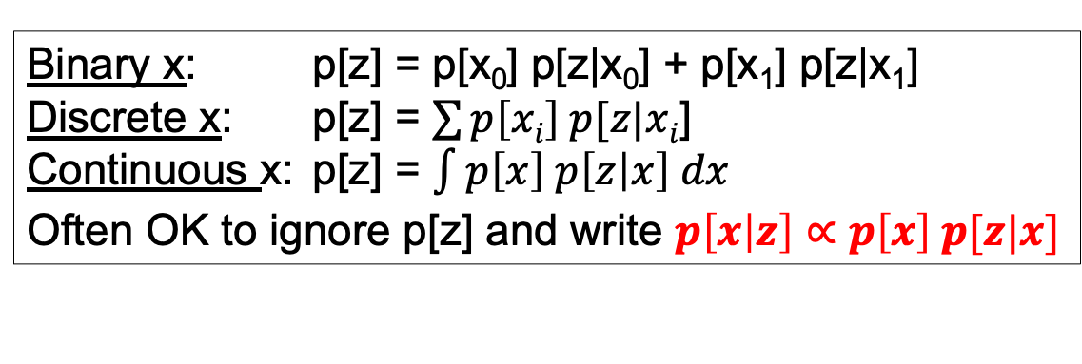
Bayes’ Theorem
Environment
x
Cause
x
System
z
Effect
z
p[x]
p[z|x]
Say we observe a value for z
What is p[x|z]?
p[x,z] = p[x] p[z|x]
= p[z] p[x|z]
⇒ p[x|z] = p[x] p[z|x] / p[z]
Binary x: p[z] = p[x₀] p[z|x₀] + p[x₁] p[z|x₁]
Discrete x: p[z] = $\sum{p\left[xi\right] p[z|xi}$]
Continuous x: p[z] = $\int{p\left[x\right] p\left[z | x\right] dx}$
Often OK to ignore p[z] and write $p\left[x | z\right]∝p\left[x\right] p[z|x]$

Slide 51
Example
Cause
x
Effect
z
x=A: Infected
X=a: Not infected
p[x]
p[z|x]
z=B: Test positive
z=b: Test negative
Low prior infection probability: p[A] = 0.01
Reliable test: p[B|A] = p[b|a] = 0.99
Test result: B
What is p[A|B]?
Binary x ⇒ p[B] = 0.01 × 0.99 + 0.99 × 0.01
Bayes: p[A|B] = 0.01 × 0.99 / p[B] = 0.5

Slide 52
A complex joint probability distribution
y₁
y₂
y₃
x₁
y₄
z₁
x₂
z₂
y₅
y₆
x₃
y₇
Updating the whole network:
If given x_{i} ⇒ Forward propagation of uncertainty
If given z_{i} ⇒ Bayes’ Theorem
If given y_{i} ⇒ ?

Slide 53
Prior, Law of Total Probability, Bayes’ Theorem
x ∈ {A,a}
y ∈ {B,b}
z ∈ {C,c}
QUESTIONS
What are p[B] and p[C]?
Say x = a. What are p[B|a] and p[C|a]?
Say y = b. What are p[A|b] and p[C|b]?
Say z = c. What are p[A|c] and p[B|c]?
x
y
z
p[B|A] = 0.9
p[B|a] = 0.6
p[C|B] = 0.9
p[C|b] = 0.2
p[A]=0.9
LTP
LTP
Prior
LTP
BT
Prior
BT
LTP
BT
1. p[B] = p[A] p[B|A] + (1-p[A]) p[B|a] = 0.9×0.9 + 0.1×0.6 = 0.87
p[C] = p[B] p[C|B] + (1-p[B]) p[C|b] = 0.87×0.9 + 0.13×0.2 = 0.81
2. p[B|a] = 0.6
p[C|a] = p[B|a] p[C|B] + (1-p[B|a) p[C|b] = 0.6×0.9 + 0.4×0.2 = 0.62
3. p[A|b] = p[A] (1-p[B|A]) / (1-p[B]) = 0.9×0.1 / 0.13 = 0.69
p[C|b] = 0.2
4. p[A|c] = p[A] p[c|A] / (1-p[C]) = 0.9*0.17 / 0.191 = 0.80
because p[c|A] = p[B|A] (1-p[C|B]) + (1-p[B|A]) (1-p[C|b]) = 0.17
p[B|c] = p[B] (1-p[C|B]) / (1-p[C]) = 0.87×0.1 / 0.191 = 0.46

Slide 54
Prior, Law of Total Probability, Bayes’ Theorem
x ∈ {A,a}
y ∈ {B,b}
z ∈ {C,c}
QUESTIONS
What are p[B] and p[C]?
Say x = a. What are p[B|a] and p[C|a]?
Say y = b. What are p[A|b] and p[C|b]?
Say z = c. What are p[A|c] and p[B|c]?
x
y
z
p[B|A] = 0.9
p[B|a] = 0.6
p[C|B] = 0.9
p[C|b] = 0.2
p[A]=0.9
pA <- 0.9 ; pB_A <- 0.9 ; pB_a <- 0.6 ; pC_B <- 0.9 ; pC_b <- 0.2
n <- 1e6
x <- rbinom( n, 1, pA )
y <- rbinom( n, 1, x*pB_A + (1-x)*pB_a )
z <- rbinom( n, 1, y*pC_B + (1-y)*pC_b )
pB <- sum(y==1) / n ; pC <- sum(z==1) / n
pB_a <- sum(x==0 & y==1) / sum(x==0)
pC_a <- sum(x==0 & z==1) / sum(x==0)
pA_b <- sum(x==1 & y==0) / sum(y==0)
pC_b <- sum(y==0 & z==1) / sum(y==0)
pA_c <- sum(z==1 & z==0) / sum(z==0)
pB_c <- sum(y==1 & z==0) / sum(z==0)

Slide 55
Conjugate Bayesian updating
p[𝝑|y] = p[𝝑] p[y|𝝑] / p[y]
If p[𝝑] and p[y|𝝑] are conjugate, then p[𝝑|y] can be calculated analytically
Gaussian - Gaussian:
Beta -
Binomial:
Dirichlet -
Multinomial:

Slide 56
Conjugate Bayesian updating of bivariate Gaussian
Prior:
Data:
Posterior:
PRA_Gauss <- function(m., S., n., thr.) {
pH <- V <- R <- rep( NA, 1e3 )
for(j in 1:1e3){
S <- riwish( n.-1, S. * (n.-1) )
m <- rmvnorm( 1, m., S/n. )
PRA <- PRA0_Gauss( m, S, thr. )
pH[j] <- PRA["pH"] ; V[j] <- PRA["V"] ; R[j] <- PRA["R"]
}
return( c( pH=mean(pH), V=mean(V), R=mean(R),
s_pH=sd (pH), s_V=sd (V), s_R=sd (R) ) )

Slide 57
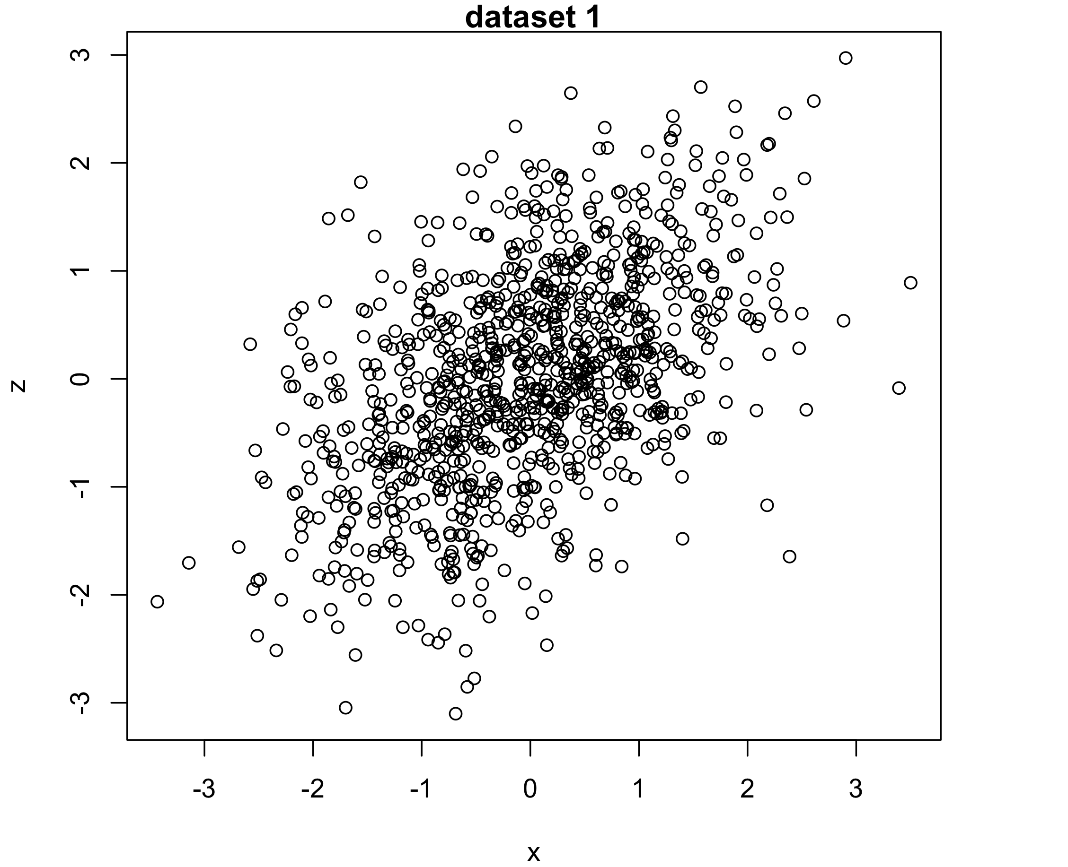
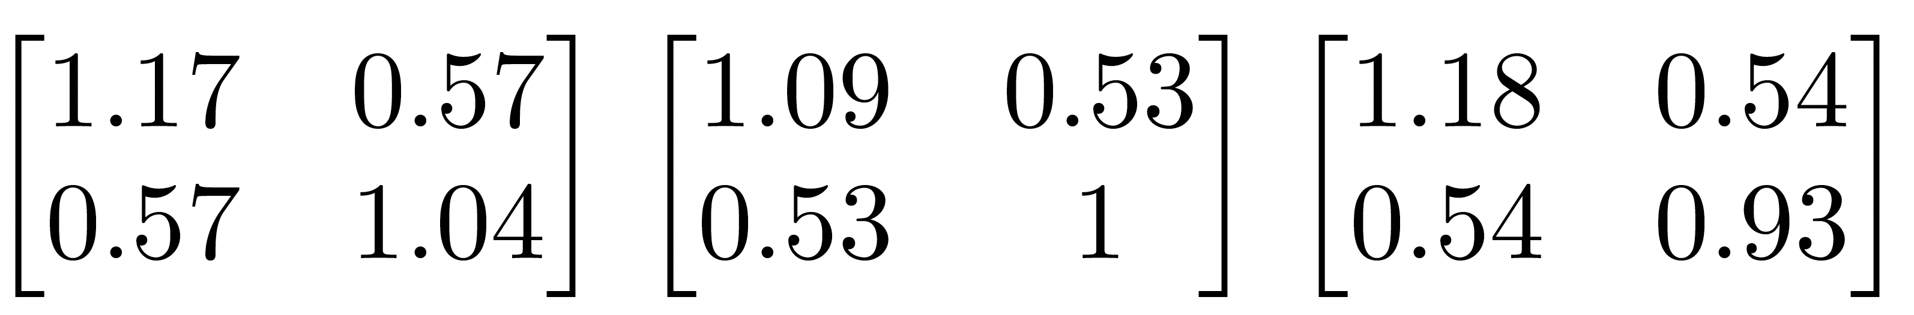
Posterior inverse-Wishart distribution
y = {n,m,S}
n = 1000
m = (-0.040,0.054)
S = (1.129, 0.537
0.537, 1.021)
riwish( n-1, S*(n.-1) )
,
,
, …

Slide 58
Non-Bayesian UQ for Bivariate-Gaussian PRA
PRA_Gauss5 <- function( m.=m, S.=S, n.=n, thr.=thr ) {
PRA <- PRA0_Gauss( m., S., thr. )
pH <- PRA["pH"] ; V <- PRA["V"] ; R <- PRA["R"]
r <- S[1,2] / sqrt( prod(diag(S)) )
VarEz_H <- (S[2,2] + r*(thr.-m[1])*(R-V) - (R-V)^2) / (n.*pH)
VarEz_NotH <- (S[2,2] + r*(thr.-m[1])* R - R^2 ) / (n.*(1-pH))
s_pH <- sqrt( pH*(1-pH) / n. )
s_V <- sqrt( VarEz_NotH + VarEz_H )
s_R <- sqrt( s_pH^2*s_V^2 + s_pH^2*V^2 + pH^2*s_V^2 )
return( c( pH, V, R, s_pH, s_V, s_R ) )
}

Slide 59
Data Germany

Slide 60
Sampling-based vs. distribution-based PRA

Slide 61
Model-based PRA

Slide 62
2. Model-based PRA
USGS CC PDM 1.0
Workshop IBS-Germany & DVFFA, Lübeck, 2025-09-24-26

Slide 63
3. Beyond the basic theory
USGS CC PDM 1.0
Workshop IBS-Germany & DVFFA, Lübeck, 2025-09-24-26

Slide 64
Extending the PRA to 2 hazardous conditions or more

Slide 65
Extending the PRA to 2 hazardous conditions or more
Drought type 1
Drought type 2

Slide 66
Multi-threshold PRA
Retrieving total (single-threshold) PRA

Slide 67
‘PRAm’: R-function for multi-threshold PRA
PRAm <- function( x, z, thr=-1:1 ) {
n <- length(x) ; n_thr <- length(thr)
H <- vector("list",n_thr)
n_H <- pH <- V <- R <- s_pH <- s_V <- s_R <- rep(NA,n_thr)
H[[1]] <- which( x < thr[1] ) ; n_H[1] <- length(H[[1]])
for(i in 2:n_thr) { H[[i]] <- which( thr[i-1] <= x & x < thr[i])
n_H[i] <- length(H[[i]])
}
n_notH <- n - sum(n_H)
H.all <- which( x < thr[n_thr] )
pH <- n_H / n
s_pH <- sqrt( pH*(1-pH) / n )
Ez_notH <- mean( z[-H.all] )
s_Ez_notH <- sqrt( var(z[-H.all] ) / n_notH )
for(i in 1:n_thr) {
Ez_Hi <- mean( z[ H[[i]]]) ; s_Ez_Hi <- sqrt( var(z[ H[[i]]]) / n_H[i] )
V[i] <- Ez_notH - Ez_Hi ; s_V[i] <- sqrt( s_Ez_notH^2 + s_Ez_Hi^2 )
}
R <- pH * V
s_R <- sqrt( s_pH^2 * s_V^2 + s_pH^2 * V^2 + pH^2 * s_V^2 )
R.sum <- sum(R) ; pH.sum <- sum(pH) ; V.wsum <- R.sum / pH.sum
return( list( sum = c( pH.sum=pH.sum, V.wsum=V.wsum, R.sum=R.sum ),
seq = cbind( thr, pH, V, R, s_pH, s_V, s_R ) ) )
}

Slide 68
Forest data from Germany revisited

Slide 69
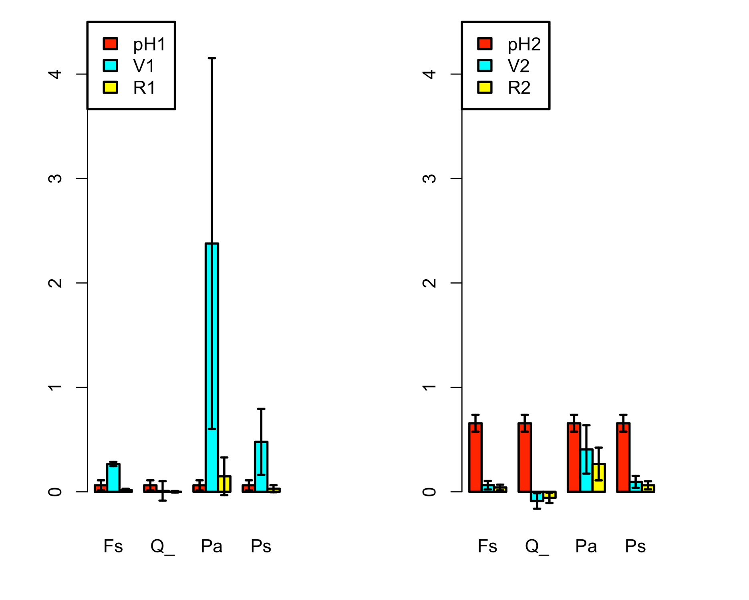
Forest data from Germany: Multi-threshold PRA

Slide 70
Forest data from Germany: EXERCISE 2
Change code: choose a series of multiple thresholds.
Discuss limitations of the multiple-threshold-PRA.

Slide 71
Forest data from Germany: EXERCISE 2
Change code: choose a series of multiple thresholds.
Discuss limitations of the multiple-threshold-PRA. Possible answers:
Mostly the same as for the single-threshold PRA.
Low n even more critical here?
…

Slide 72
Continuous single-threshold PRA
Retrieving total (single-threshold) PRA

Slide 73
Extending the PRA from 2 risk-components to 3
64 different
2-component PRAs at cell level:
1 single
3-component PRA at regional level:
P[H] = 0.27
Q = 37/64
V = 0.26
R = 0.04

Slide 74
Extension to R = Q p[H] V
g m⁻² y⁻¹
-
g m⁻² y⁻¹
R = p[H] V
g y⁻¹
m²
g m⁻² y⁻¹
-
R = Q p[H] V
Q = area (or # individuals) exposed to the risk factor

Slide 75
Interacting hazards

Slide 76
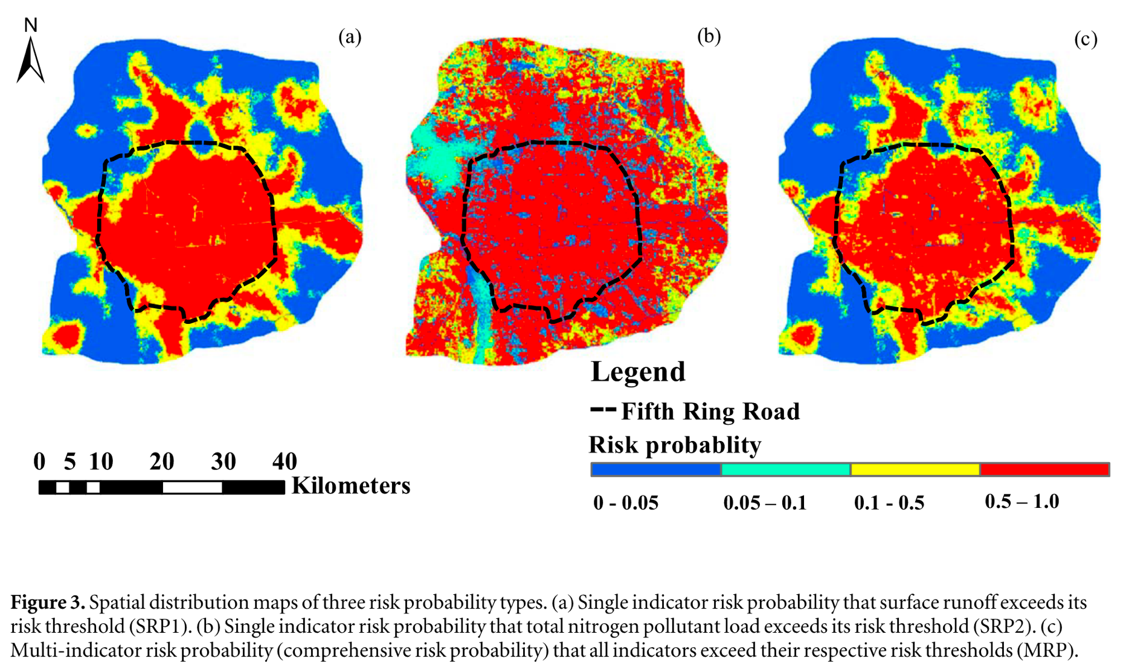
Liu et al. (2020). A new risk probability calculation method for urban ecological risk assessment
Two marginal hazard distributions
Joint distribution formed by copula

Slide 77
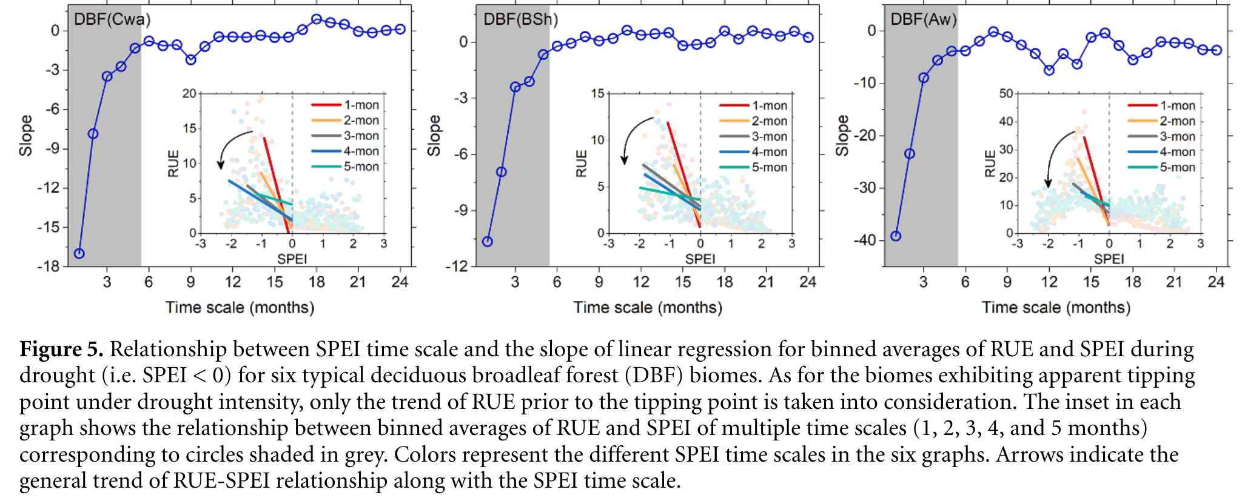
Chen et al. (2020). The collapse points of increasing trend of vegetation rain-use efficiency under droughts

Slide 78
PRA for heatwaves (T>30°C) as f(mean(T),sd(T))

Slide 79
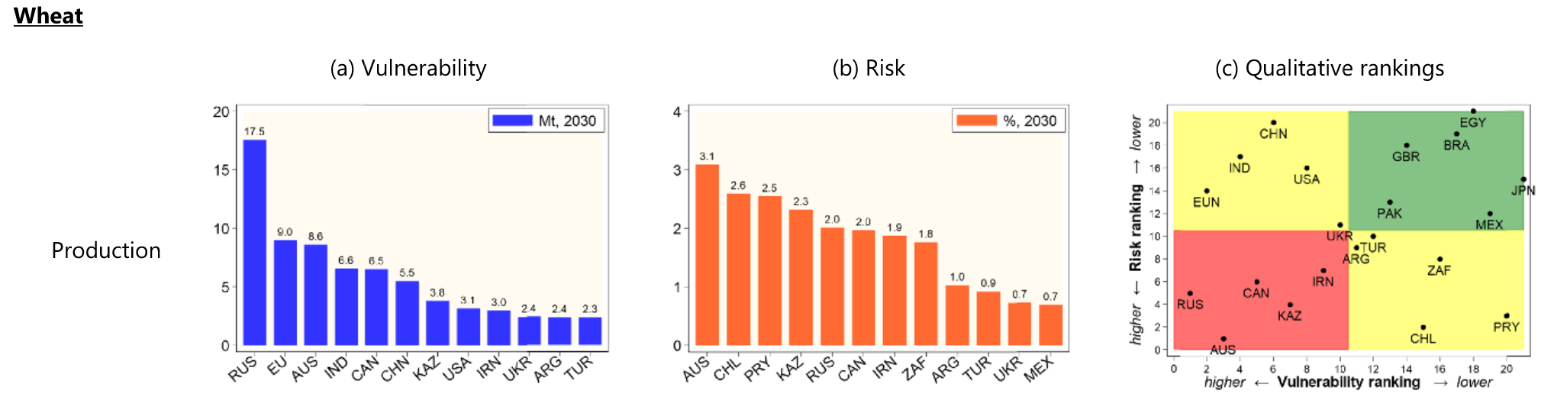
Chatzopoulos et al. (2021). Potential impacts of concurrent and recurrent climate extremes on the global food system by 2030
Concurrent climate extremes
Recurrent climate extremes
V_{glob} = f(spatial distrib. of H)
V_{glob} = f(temporal distrib. of H)

Slide 80
Example of H-interaction with modelled data
Make models that generate values for two or three different hazards. Examine two different versions:
Assume the p[Hi] are independent
Assume correlations
See my handwritten note (single A4)

